Slide 1
When to use MLP, CNN, and RNN Neural Networks
By Aymen Tariq

Slide 2
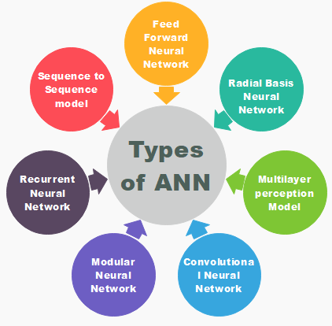
Choosing an appropriate neural network
Nowadays, there is a plethora of neural networks to select from
Also, new models are being researched each day
The majority networks are flexible enough to make prediction even
on the wrong type of prediction problem or data
It is important to know which neural network works well for a
given prediction problem

Slide 3
Important Neural Networks to Focus on
Multilayer Perceptrons (MLPs)
Convolutional Neural Networks (CNNs)
Recurrent Neural Networks (RNNs)

Slide 4
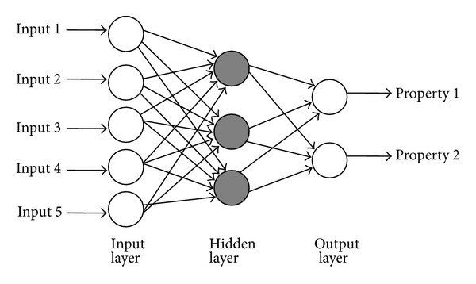
When to use Multilayer Perceptrons?
MLPs are a classical type of neural network that can be used
when inputs are assigned a label or a class
for tabular datasets
for Classification prediction problem
for Regression prediction problems

Slide 5
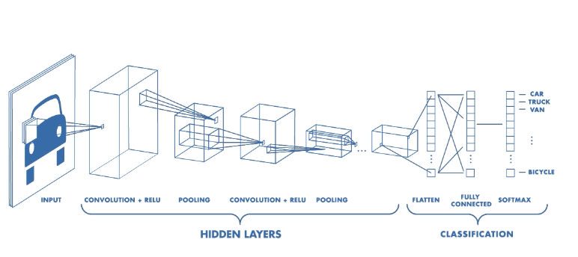
When to use Convolutional Neural Network?
CNN was specifically designed to process pixel data or images
However, it can be used for other types of data that involve spatial relationships
It can be used for
image data
regression prediction problems
classification prediction problems
It proved to work well for document classification
employed in sentiment analysis and associated
problems

Slide 6
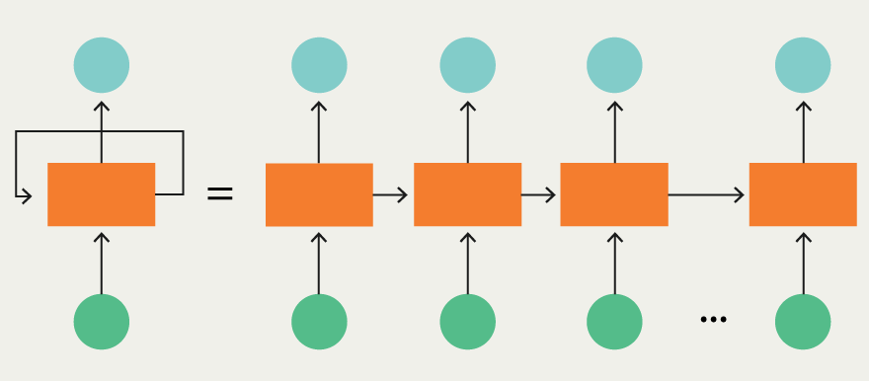
When to use Recurrent Neural Network?
RNN are difficult to train and were designed specifically for Natural Language Processing tasks or sequential prediction problems
It can be used for
Speech Data
Text data
Regression prediction problem
Classification prediction problem
Generative models
Don’t use it for
Image data
Tabular data

